Slide 1

3. Hardware Architecture
Core Components
Camera Module: Seeed Studio XIAO ESP32S3 Sense with integrated camera
Sensing Module: RPLIDAR A1 for 2D mapping + HC-SR04 ultrasonic sensor for obstacle detection
Mobility Chassis: Dagu Wild Thumper 6WD for robust movement
Microcontroller: Seeed Studio XIAO ESP32S3 for processing and control
Audio System: ReSpeaker 4-Mic Array and Adafruit I2S 3W Class D Amplifier
Integration
Central Processing: Microcontroller coordinates all sensor inputs and outputs
Communication Protocols: I2C for microphone array, PWM for motor control
Power Management: Designed for efficient operation across all components

Slide 2
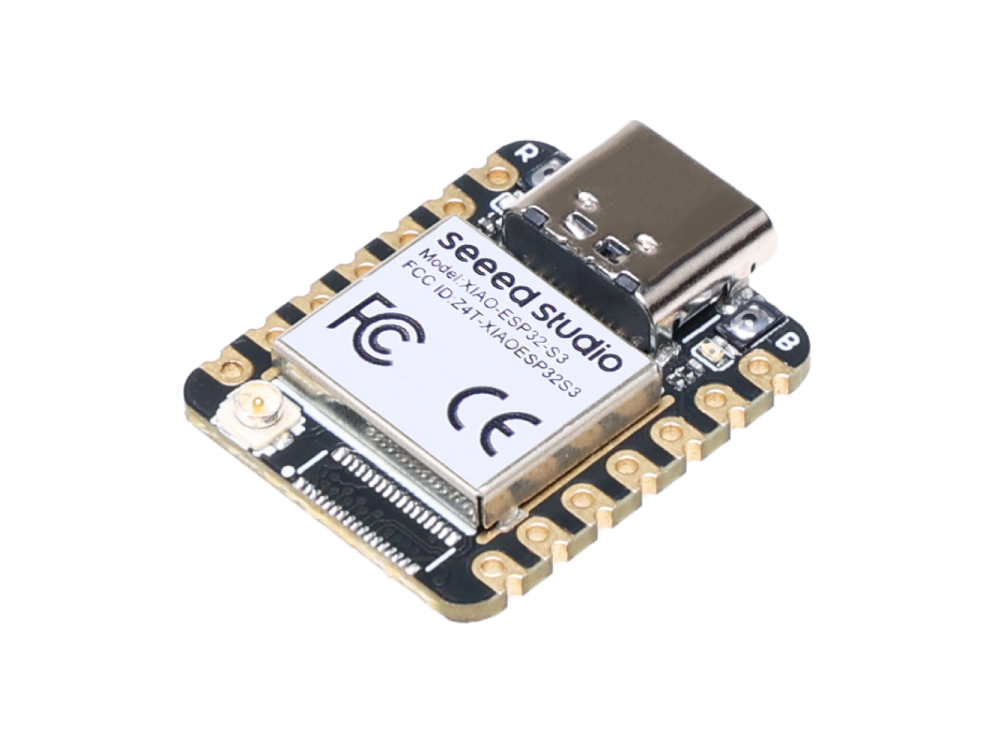
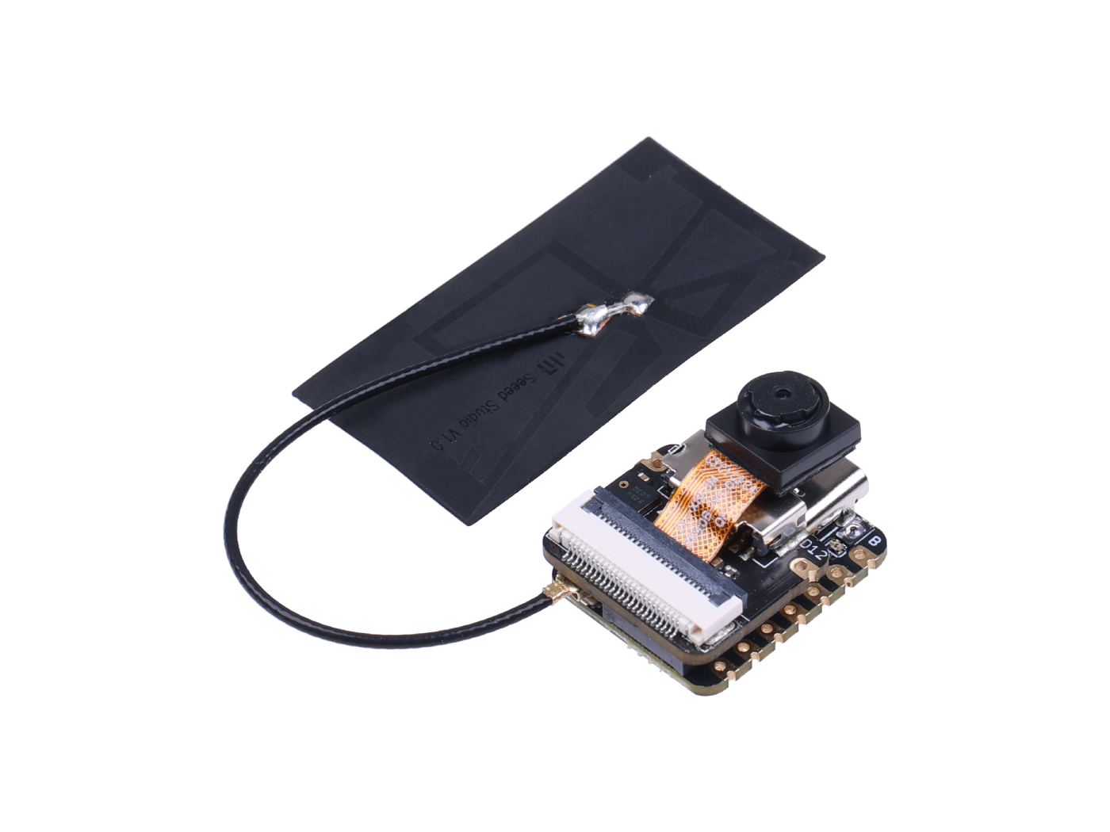
3. Hardware Architecture
Seeed Studio XIAO ESP32S3 ＆ Sense
Hardware Features
Rich Interfaces: Supports Wi-Fi, Bluetooth, UART, I2C, SPI, and other communication interfaces.
Integrated Sensors: Built-in camera (OV2640) and digital microphone for image and voice capture.
AI Service
Software Services:Introduces the Watcher software framework, which supports cloud, hybrid, and on-premises deployment to ensure data privacy and efficient processing.
Development Platform:SenseCraft is an online development environment that supports the full workflow for TinyML applications, suitable for low-power devices.
Training and Workshops:Provides AI workshops to help developers quickly get started with TinyML, deploying AI models using the XIAO ESP32S3 Sense development board.

Slide 3
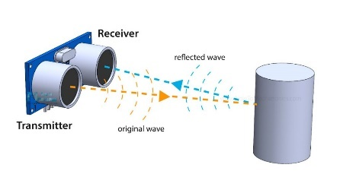
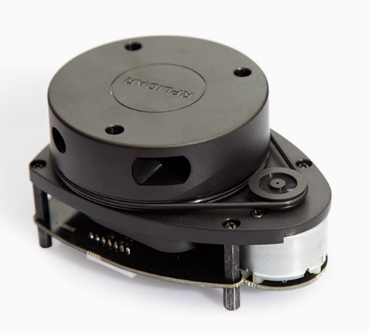
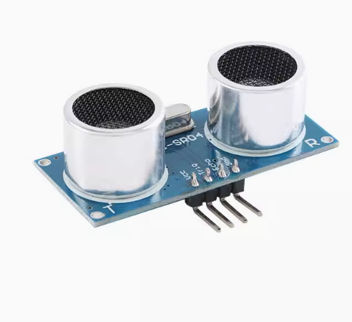
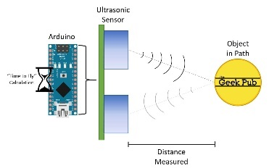
3. Hardware Architecture
RPLIDAR A1 ＆ HC-SR04 ultrasonic sensor
Function:The RPLIDAR A1 is a 2D laser radar that can perform 360° omnidirectional laser distance measurement and scanning, suitable for robot navigation, environmental modeling, and map building.
Advantages:It features high precision, high resolution, long service life, safety, and plug-and-play convenience, making it suitable for a variety of environments.
Theory:The HC-SR04 ultrasonic sensor calculates distance by measuring the propagation time of ultrasonic pulses in the air and using the known speed of sound.
Advantages:It offers high precision, stability, and ease of integration at a low cost, making it suitable for applications like robot obstacle avoidance, smart home automation, and industrial automation.

Slide 4
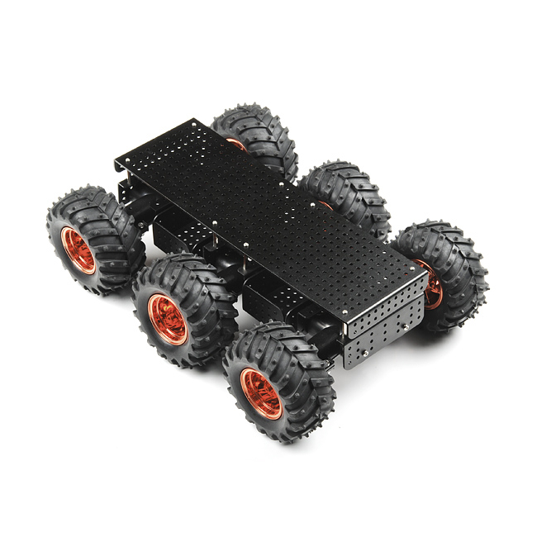
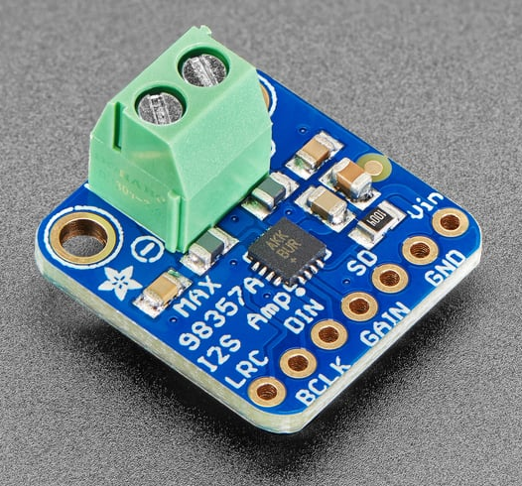
3. Hardware Architecture
Adafruit I2S 3W Class D Amplifier ＆ Dagu Wild Thumper 6WD
Function:The Adafruit I2S 3W Class D Amplifier is a digital audio amplifier module that receives digital audio input in the I2S standard, decodes it into an analog signal, and then directly amplifies it to drive a speaker.
Advantage:This module uses Class D amplification technology, which is highly efficient and suitable for portable and battery-powered projects. It also features over-temperature and over-current protection.
Function:The Dagu Wild Thumper 6WD is a robust six-wheel-drive robotic chassis designed for navigating rough and uneven terrains.
Advantage:It combines high load capacity with excellent off-road performance, making it ideal for demanding robotic applications.

Slide 5
3. Hardware Architecture
Budget price list
Name | Price（RMB）
HC-SR04 | 4.64
MAX98357A | 10.00
XIAO ESP32 S3 Sense | 79.00
RPLIDAR A1 | 927.84
Dagu Wild Thumper 6WD | 2599.65
Total | 3621.13

